Slide 1
Smith & Robbins Superstore
Sales Performance Analysis
Olumide Balogun +234-8065060691
1

Slide 2
In light of the competitive landscape, Smith & Robbins Stores seeks to evaluate its performance. The company has tasked us with developing automated sales performance dashboards that deliver quick and up-to-date insights to support data-driven decision-making, enhance customer relationships, improve financial performance, and facilitate informed strategic planning. Additionally, we will provide future projections for sales, profit, and quantity over the next three years.
The sales performance dashboards will include: the Sales Dashboard, the Customer Dashboard, and the Seasonality and Forecast Dashboard.
The Goal
Olumide Balogun +234-8065060691
2

Slide 3
These automated (functional and dynamic) sales performance dashboards offer a comprehensive analysis of Smith & Robbins' sales performance from 2020 to 2023. The primary objective is to uncover insights into sales performance and profitability, enabling the identification of patterns, key trends, performance gaps, customer behavior, seasonality, and three-year projections. Additionally, these insights will highlight areas for improvement, ultimately enhancing sales performance, fostering better customer relationships, improving profitability, and supporting informed strategic business decisions.
Executive
Summary
Olumide Balogun +234-8065060691
3

Slide 4
The Task: Sales Performance Dashboards.
Approach, Analysis and Technical Challenges
Dashboard Components
Success Criteria
Final Report
Contents
Olumide Balogun +234-8065060691
4

Slide 5
Sales Performance Dashboards
Introduction
Smith & Robbins Stores have outlined the specifications for developing three dashboards in Tableau. These dashboards are designed to assist stakeholders, including the Sales, Marketing, and Customer Service teams, as well as executives, in analyzing sales performance, customer insights, and projections.
Sales Dashboard | Requirements
Dashboard Purpose
The purpose of the Sales Dashboard is to provide an overview of sales metrics and trends, enabling users to analyze year-over-year sales performance and gain insights into sales trends.
Key Requirements
KPI Overview
Provide a summary of total sales, profit, and quantity for both the current year and the previous year.
Olumide Balogun +234-8065060691
5

Slide 6
Sales Trends
Present the data for each Key Performance Indicator (KPI) on a monthly basis for both the current and previous years.
Highlight the months with the highest and lowest sales to ensure they are easily recognizable.
Product Subcategory Comparison
Analyze the sales performance across various product subcategories for both the current and previous years.
Include a comparison of sales figures alongside profit margins.
Weekly Trends for Sales and Profits
Present weekly sales and profit data for the current year.
Show the average weekly sales and profit values.
Highlight the weeks that exceed and fall below the average to emphasize variations in sales and profit performance.
Olumide Balogun +234-8065060691
6

Slide 7
Customer Dashboard | Requirements
Dashboard Purpose
The Customer Dashboard is designed to offer a comprehensive overview of customer data, trends, and behaviors. It will assist the marketing and sales teams, as well as management, in understanding customer segments and enhancing customer satisfaction.
Key Requirements
KPI Overview
Provide a summary of the total number of customers, total sales per customer, and total number of orders for both the current year and the previous year.
Customer Trends
Show monthly data for each Key Performance Indicator (KPI) for both the current year and the previous year.
Clearly highlight the months with the highest and lowest sales to ensure they stand out.
Olumide Balogun +234-8065060691
7

Slide 8
Customer Distribution by Number of Orders
Visualize the distribution of customers according to the number of orders they have placed. This will provide valuable insights into customer behavior, loyalty, and engagement.
Top 10 Customers by Profit
Display the top 10 customers who have contributed the highest profits to the company.
Include additional details such as rank, number of orders, current sales, current profit, and the date of their last order.
Seasonality and Forecast Dashboard | Requirements
Dashboard Purpose
The Seasonality and Forecast Dashboard is designed to provide insights into the seasonality and trends of sales, profit, and quantity, along with moving averages. It will project sales, profit, and quantity for a minimum of the next three years.
Olumide Balogun +234-8065060691
8

Slide 9
Key Requirements
Monthly Trends and Seasonality for Sales, Profit and Quantity
Illustrate trend lines for monthly sales, profit, and quantity.
Present the average monthly values.
Include a three-month moving average for sales, profit, and quantity.
Forecast for Sales, Profit and Quantity
Provide projections for sales, profit, and quantity over a minimum of the next three years.
Design & Interactivity | Requirements
Dashboard Dynamics
The dashboard should enable users to explore historical data by providing the flexibility to select any desired year.
Olumide Balogun +234-8065060691
9

Slide 10
Ensure easy navigation across the dashboard for users.
Make charts and graphs interactive, allowing users to filter and explore data directly through them
Data Filters
Allow users to filter data based on product details such as category and subcategory, as well as location information including region, state, and city.
Olumide Balogun +234-8065060691
10

Slide 11
Approach, Analysis and Technical Challenges
Collected data tables from the Management team.
Established data relationships (as a unified dataset), then formatted, compiled, and cleaned the data.
Renamed fields/tables and changed data types as needed.
Created calculated fields.
Built charts and tables.
Developed automated (functional and dynamic) dashboards. The designs were created in PowerPoint, with added icons, filters, and interactive features.
To see the functionality and dynamic nature of the dashboard: Go to https://public.tableau.com/app/profile/olumide.balogun1/vizzes
Olumide Balogun +234-8065060691
11

Slide 12
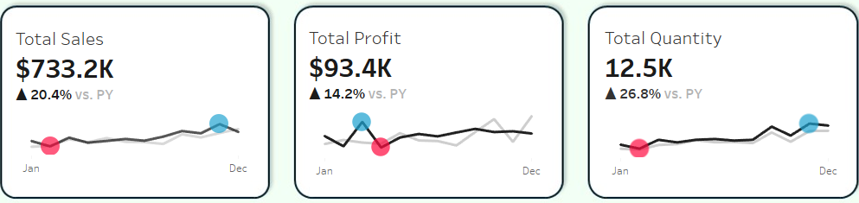
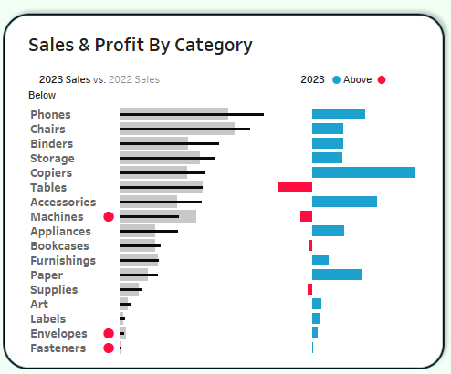
Sales Performance Dashboards Components
Sales Dashboard Components - Key Requirements
1. KPI’s and Sales Trends - Using BANs for the KPIs and Sparklines for the Sales Trends
2. Product Subcategory Comparison - Using Bar - in - Bar
12

Slide 13
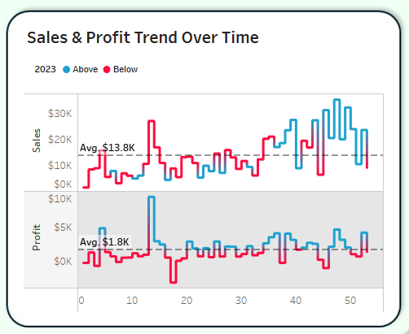
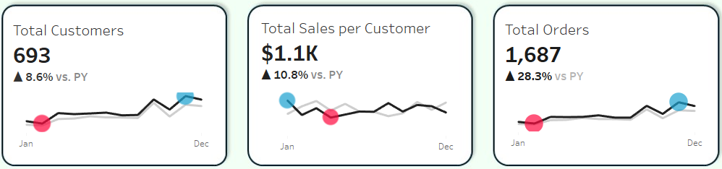
3. Weekly Trends for Sales and Profit - Using Line Chart.
Customer Dashboard Components - Key Requirements
1. KPI’s and Customer Trends - Using BANs for the KPIs and Sparklines for the Sales Trends
13

Slide 14
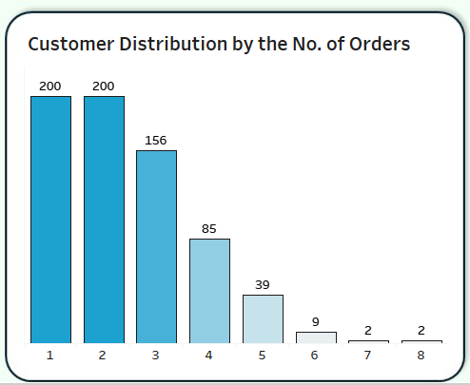
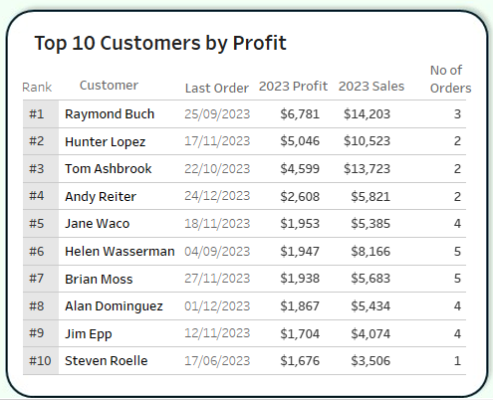
2. Customer Distribution by Number of Orders - Using Histogram.
3. Top 10 Customers by Profit - Using Table.
14

Slide 15
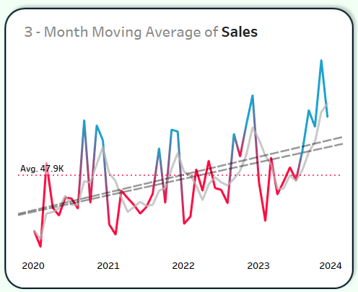
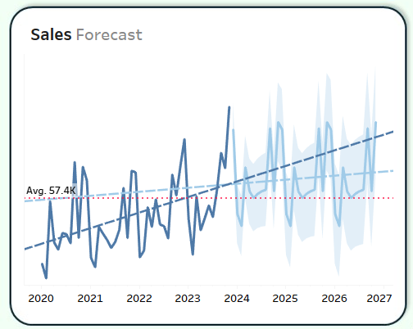
Seasonality & Forecast Dashboard Components - Key Requirements
1. Seasonality and Trends - Using Line Chart.
2. Projection - Using Line Chart.
15

Slide 16
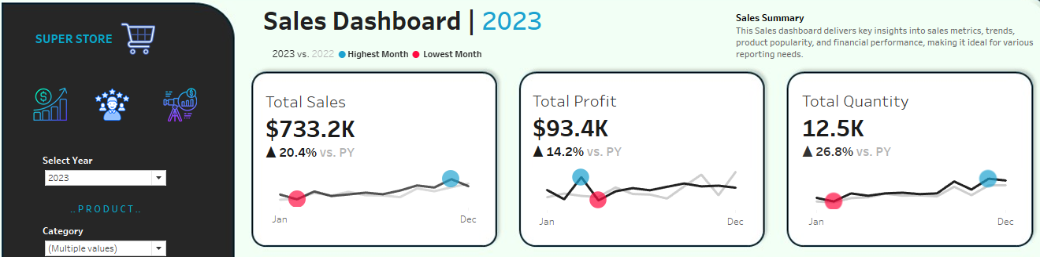
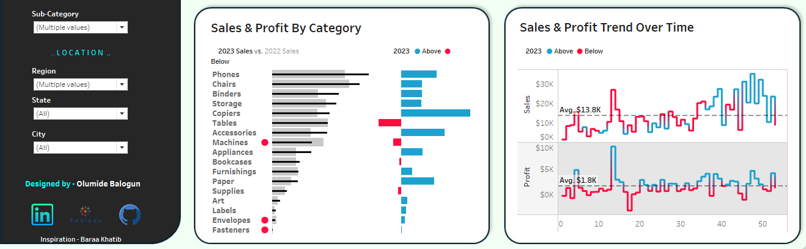
Olumide Balogun +234-8065060691
16

Slide 17
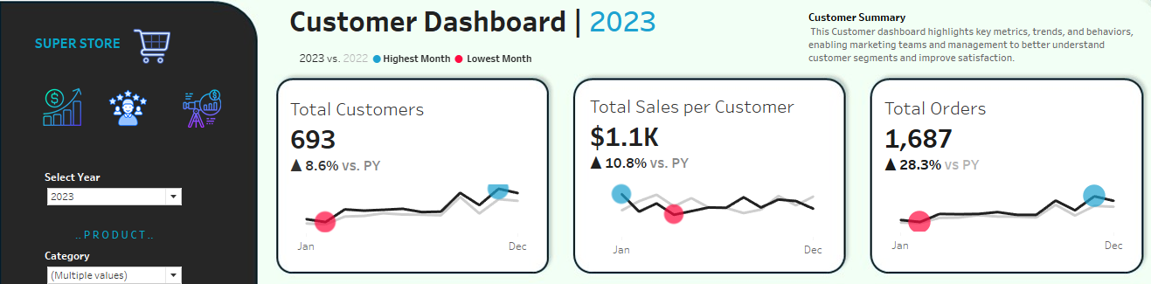
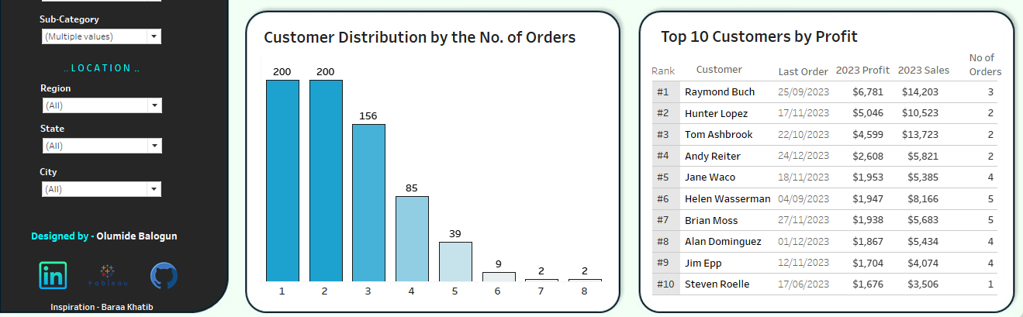
Olumide Balogun +234-8065060691
17

Slide 18
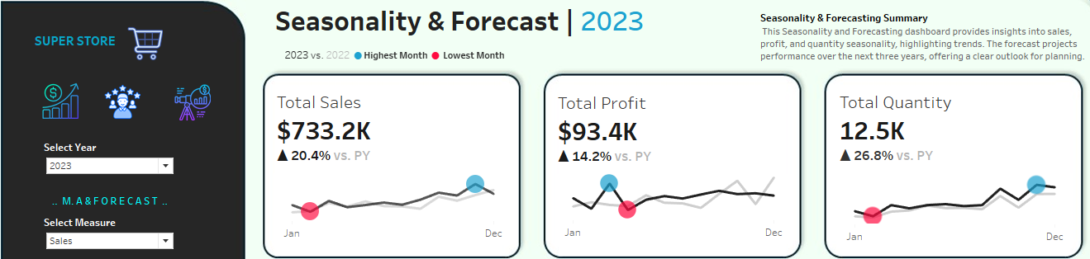
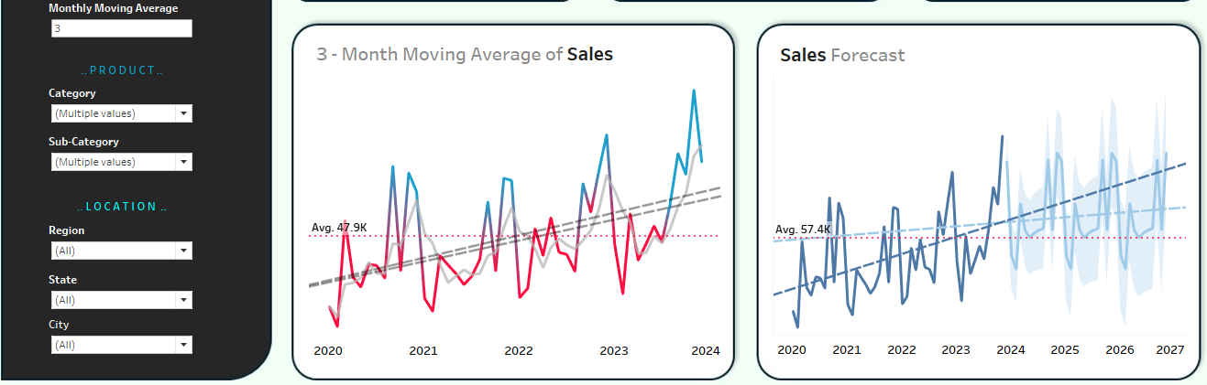
Olumide Balogun +234-8065060691
18

Slide 19
Success Criteria
After this Sales Performance Dashboards:
Strategic business decisions will be made to reduce costs by 15% to 20%.
The sales team will make more informed decisions, improve customer relationships, and reduce marketing expenses by 10%.
Sales analysts will automate data gathering, saving 20% of their time to focus on higher-value activities.
The executive team will make better financial decisions and develop informed strategic plans, leading to a 15% to 20% increase in profit.
To see the functionality and dynamic nature of the dashboard: Go to https://public.tableau.com/app/profile/olumide.balogun1
Olumide Balogun +234-8065060691
19

Slide 20
Final Results
Is there a significant year-on-year difference in Sales, Profit, and Quantity?
Hypothesis: Yes, there is a clear and significant year-on-year difference.
2. Is there a significant year-on-year difference in the Number of Customers and Orders?
Hypothesis: Yes, there is a clear and significant year-on-year difference.
3. Do the Profit and Quantity trends mirror the Sales trend?
Hypothesis: Yes, they do.
Which months show notable seasonality in Sales, Profit, and Quantity?
Answer: September, November, and December stand out.
Does the projection shows remarkable progress for the company? Does the projection indicate remarkable progress for the company?
Hypothesis: Yes, the projection shows significant progress.
Olumide Balogun +234-8065060691
20

Slide 21
For comprehensive Descriptive, Diagonistics, Predictive and Prescriptive Analysis that involves:
Total Sales, Profit and Quantity along their Respective Percentage Growth
Top 15 Categories, Segments, and Regions by Sales and Profit
Analysis of Sales Performance and Profitability by Segment and Category Across Regions
Top-Performing Subcategories
Monthly Sales Cyclical Patterns
Month-over-Month Sales Comparison Using Time Series Analysis
The Impact of Quantity, Discount on Sales and Profitability
Features with the Greatest Impact on Sales and Profit Outcomes– Using Feature Importance and Regression Model
Trends and Seasonality in Sales
Forecasting Sales using ARIMA Model
Customer Segments That Drive the Most Sales
Go to : https://github.com/olumidebalogun1/Superstore-Sales-Perfomance-Analysis-Using-R-Language
Olumide Balogun +234-8065060691
21

